Slide 1

GOVERNMENT COLLEGE OF ENGINEERING SRIRANGAM TRICHY - 620012
TASKDO - TASK MANAGEMENT SYSTEM
GUIDED BY
Mr H.SHEIK MOHIDEEN,
AP/CSE,
GCE-SRIRANGAM.
SUBMITTED BY
Govarthana K (830119104013)
Mohamed Farhan S (830119104023)
Sivasankaranarayanan D (830119104045)

Slide 2
OVERVIEW
Problem Statement
Domain
Abstract
System specification
Existing system
Disadvantages of existing system
Proposed system
Advantages of Proposed system
System architecture
Modules
Flow Chart
Conclusion
Reference

Slide 3
PROBLEM STATEMENT
Many working professionals like head of the department and professors often find time management as a problem for successful task accomplishment.
One of the key reasons for failure in task accomplishment is inefficient planning of the tasks.
There are many task management and to-do-list applications, but most of them do not advise on optimal task management and guidance for optimal performance.

Slide 4
DOMAIN
WEB DEVELOPMENT
Web development is basically building applications for the web (world wide web) or an intranet ( a private network)
It can range from developing a simple single static page of plain text to complex web applications, electronic businesses and social network services.
There are three kinds of web development: front-end development, backend development and full stack development

Slide 5
ABSTRACT
Time management has always been a problem for all people, especially for working professionals.
This website is used by the head of the department of a college to monitor the professors work given by them
Professors can know the details and time at which the work should be done
Using this website head of the department can login and assign tasks for their department professors and rate them.
Professors can login and view their tasks assigned by the head of the department

Slide 6
SYSTEM SPECIFICATION
Hardware requirements
Hard disk: 1gb
RAM : 1gb
Software requirements
Operating System : Any
Any browser

Slide 7
TECHNOLOGIES USED
FRONTEND
HTML
CSS
React js
BACKEND
Mongo db
Express js

Slide 8
EXISTING SYSTEM
Applications that has the options to take notes, track down the daily tasks, and applications that are made to assign and track the tasks for students.
Examples : Samsung notes, Keep notes, Blackboard learn etc.

Slide 9
DISADVANTAGES OF EXISTING SYSTEM
Some of the existing system are made just to track tasks with no roles such as for students,headmaster and so on.
Other existing system are made for students to do their work assigned by the teachers
Some of the exisiting systems are not available for free
Also these existing system lacks rating system

Slide 10
PROPOSED SYSTEM
The proposed system is a web application that will help head of the department to assign tasks for the professors and track them.
The professors, once completed can mark their task as completed.
The head of the department can also rate the tasks of the professor based on how well they performed it.

Slide 11
ADVANTAGES OF PROPOSED SYSTEM
Professors can never forget the task which they left to do
HODs can now easily assign tasks online
No use of papers
Tasks remain safe on the database
HODs can check and rate the tasks of the professors using just a browser based on their performance and the professors will know the rating

Slide 12
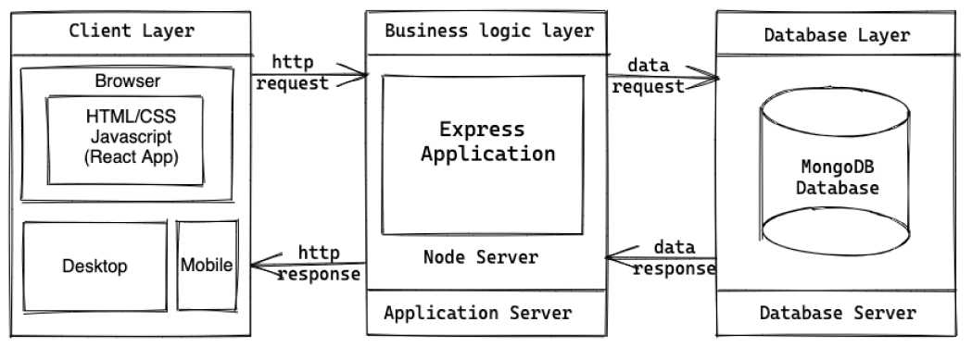
SYSTEM ARCHITECTURE

Slide 13
MODULES
User creation
User login
Task assignment
Task completion
Task rating

Slide 14
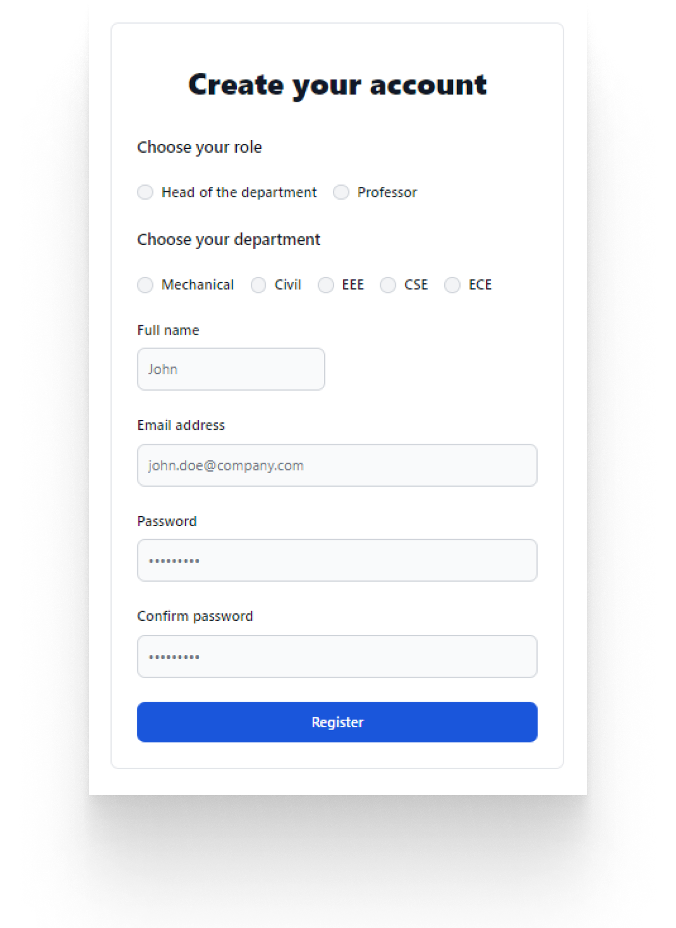
MODULE 1
User creation
Description
In this module the user can create an account as head of the department or professor
The data will be verified and if everything is fine, your account gets created successfully

Slide 15
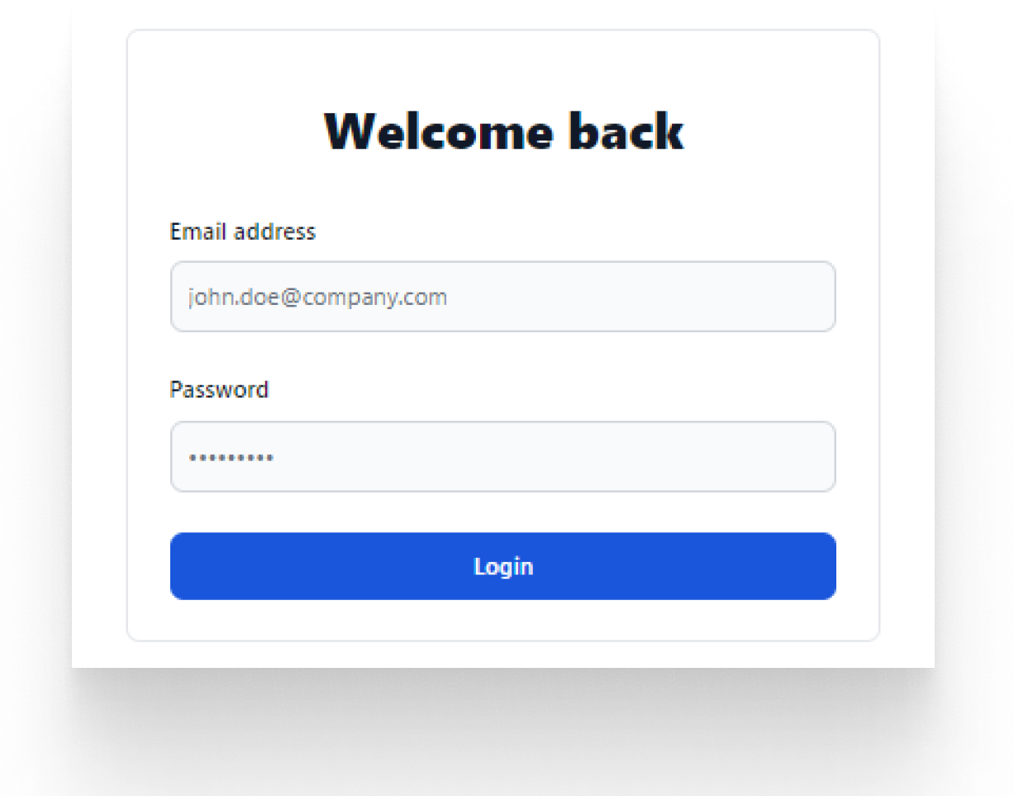
MODULE 2
User login
Description
In this module any user , it can be head of the department or a professor can log in with their credentials.
They will be logged in accordingly
When the credentials are right, access token will be generated in the backend and will be used for each request

Slide 16
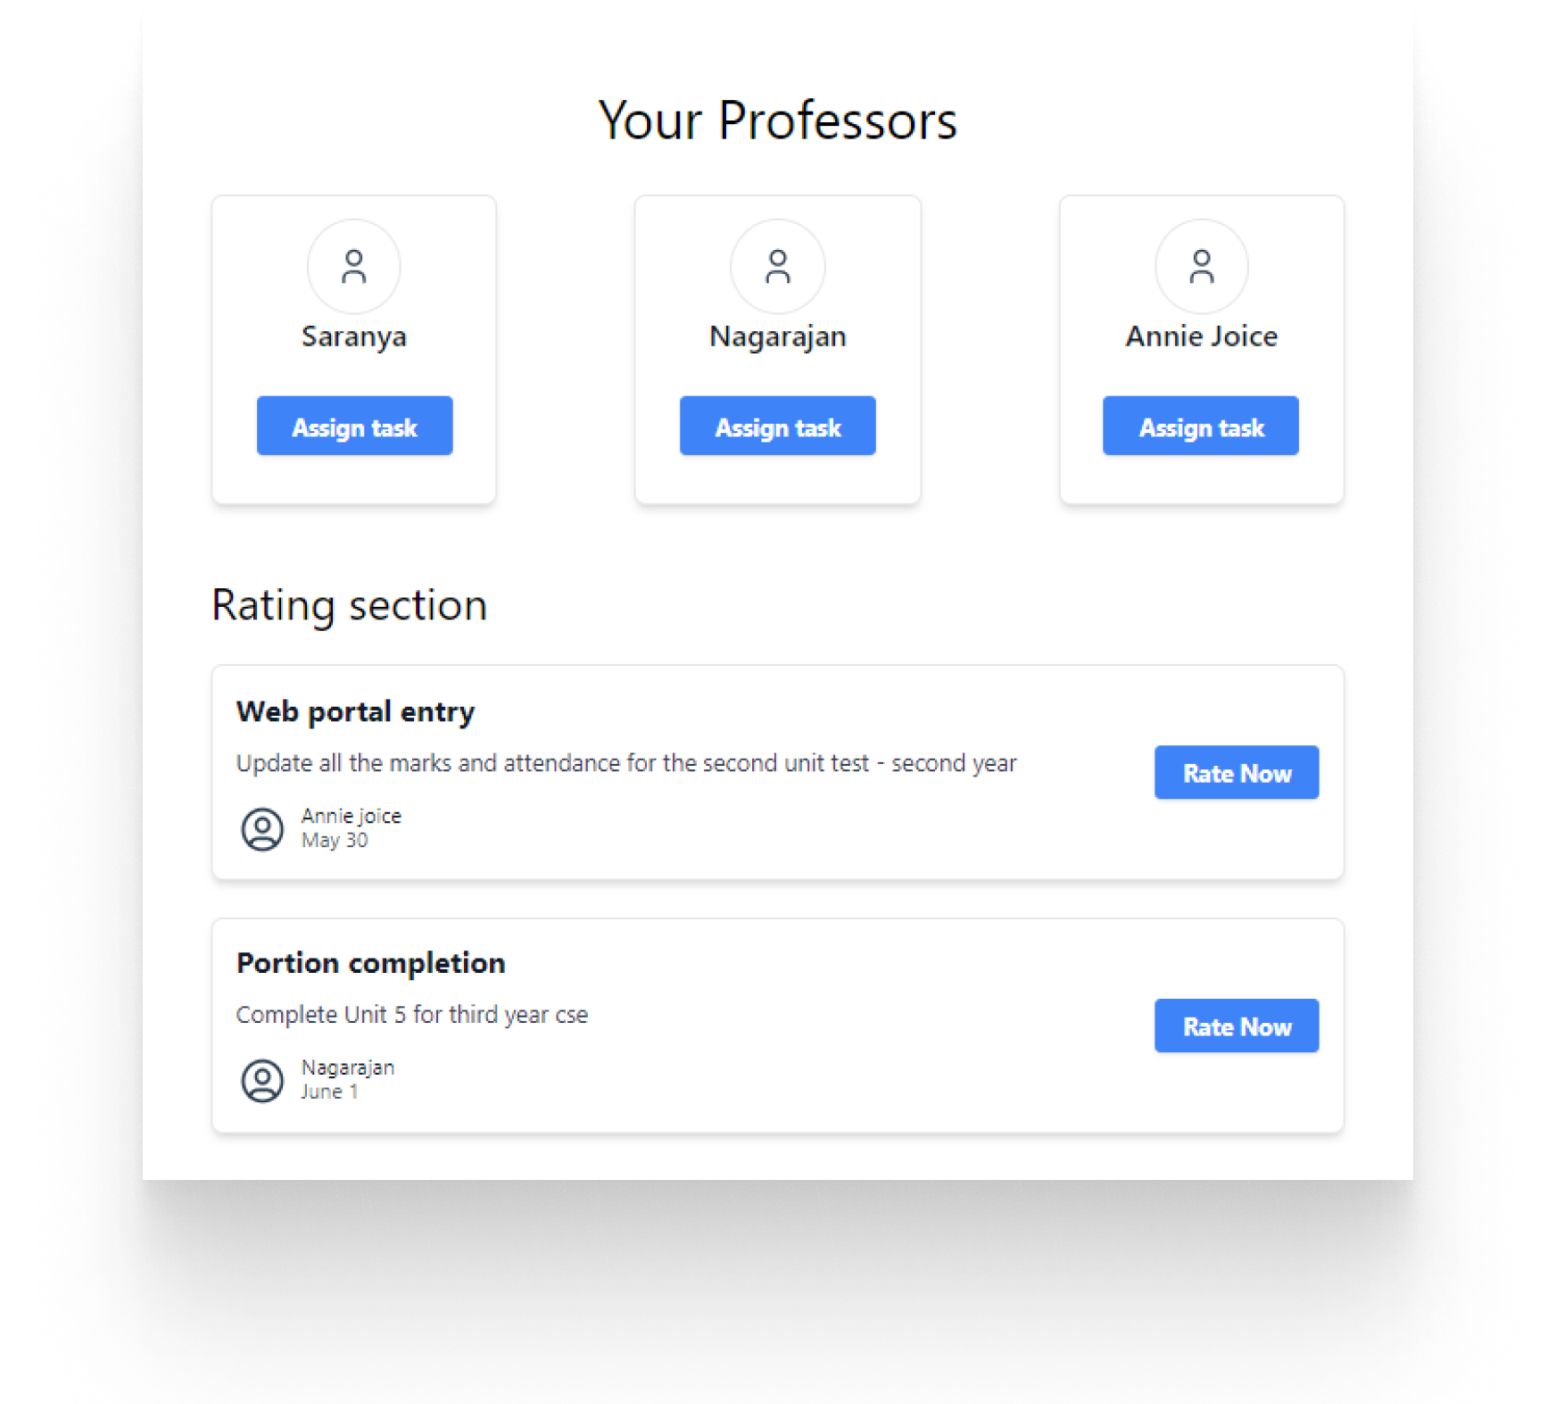
MODULE 3
Task assignment
Description
In this module the head of the department can assign task to the professors present in their respective department

Slide 17
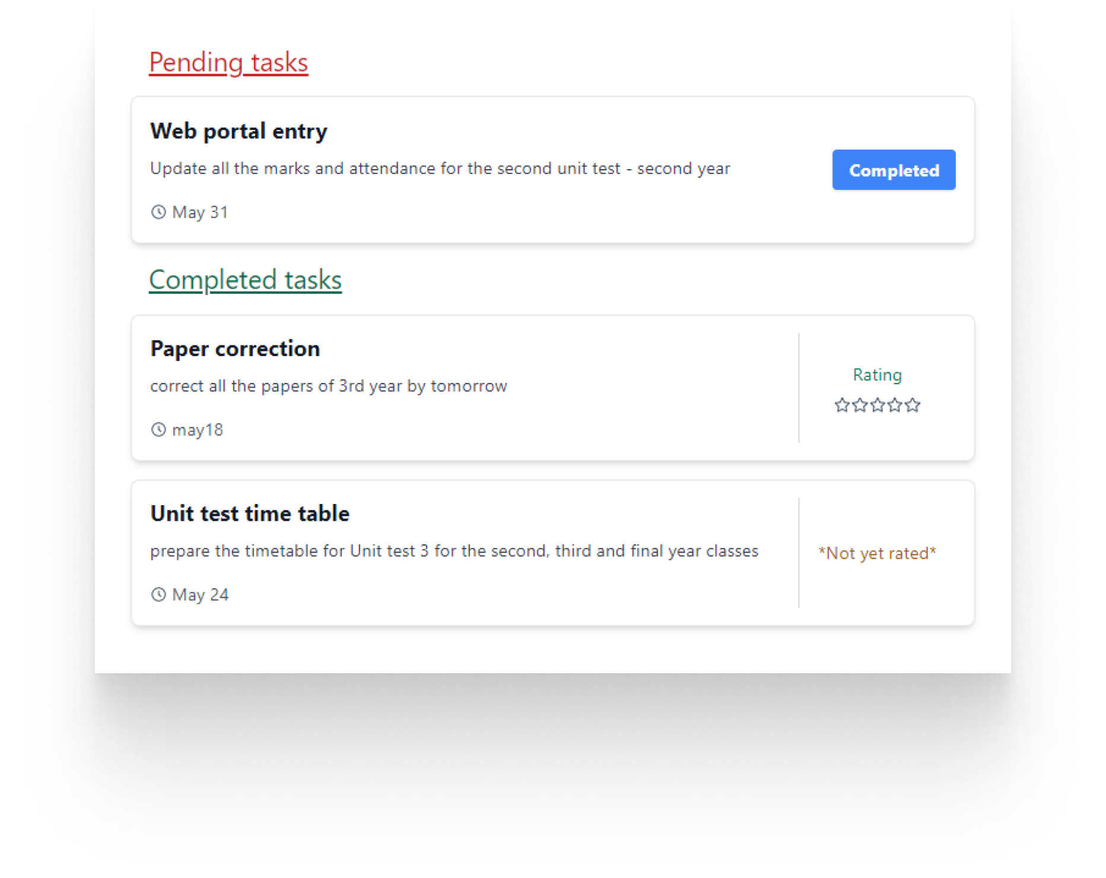
MODULE 4
Task Completion
Description
In this module, the professors can set the current status of the task
It is organized into two sections pending and completed tasks

Slide 18
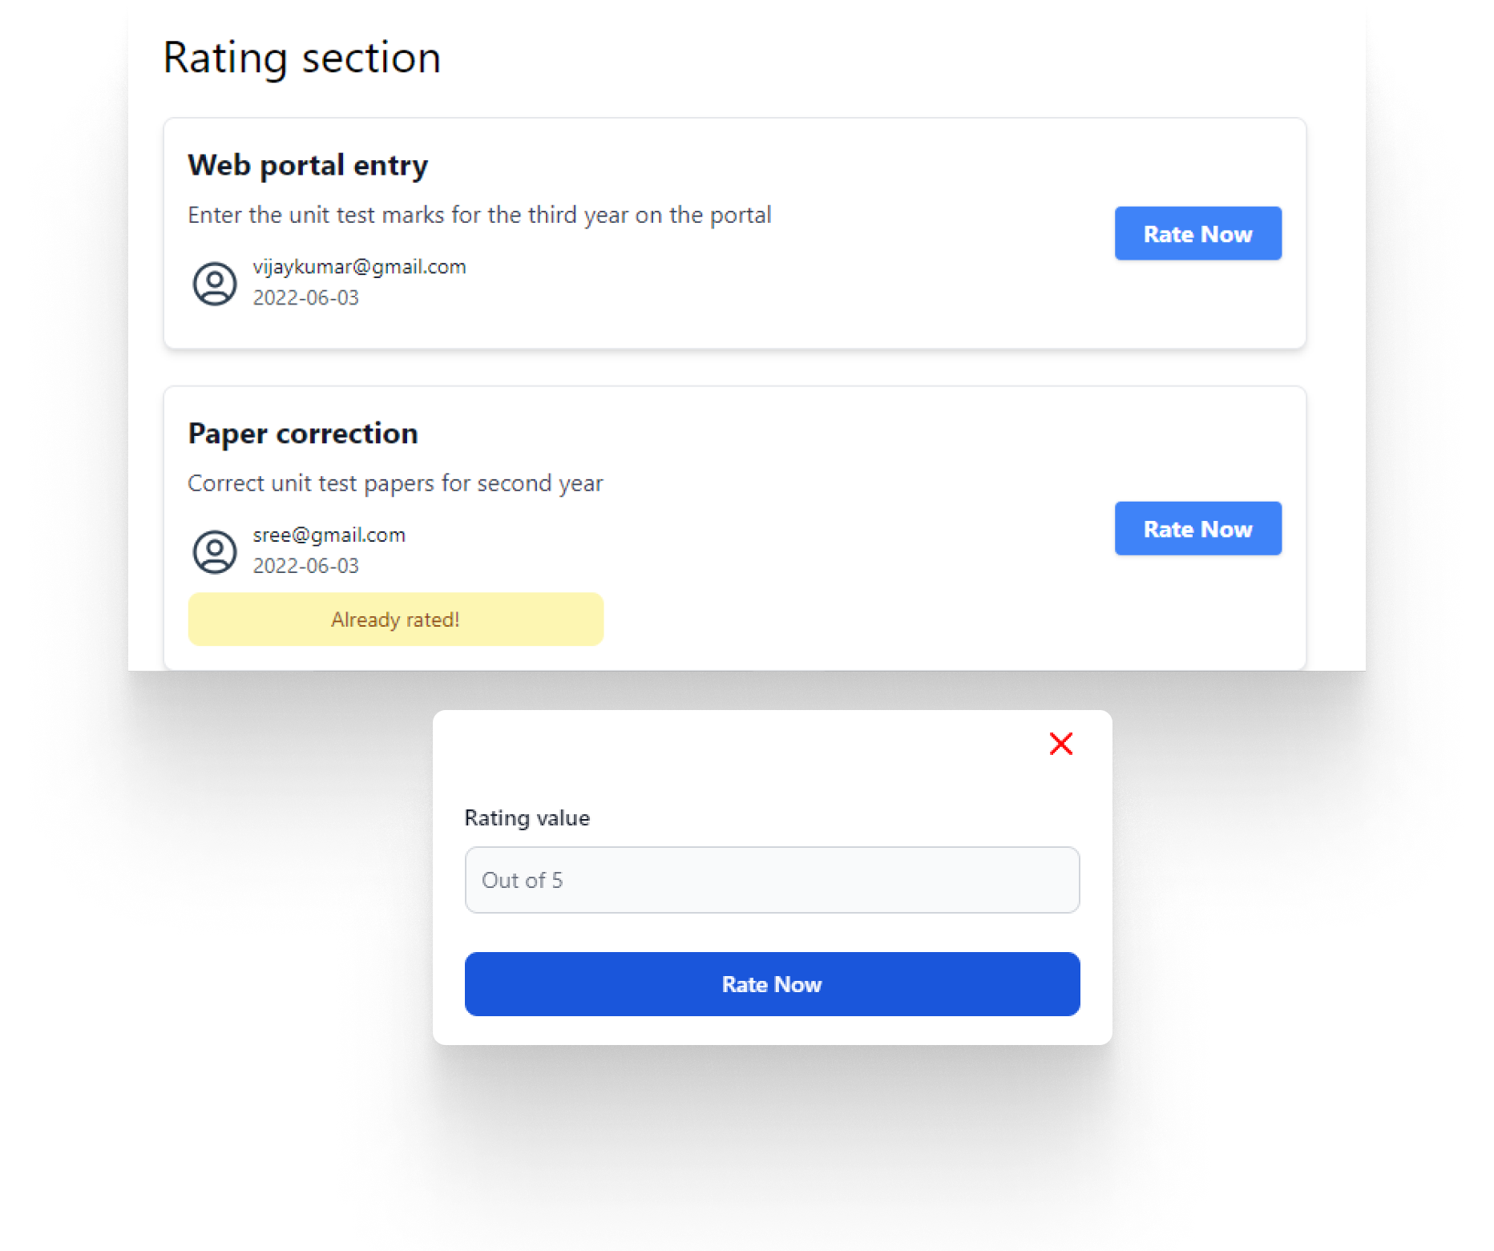
MODULE 5
Task Rating
Description
In this module, the head of the department will rate their professors tasks out of 5
The professors will be able to see their task rating on their homepage

Slide 19
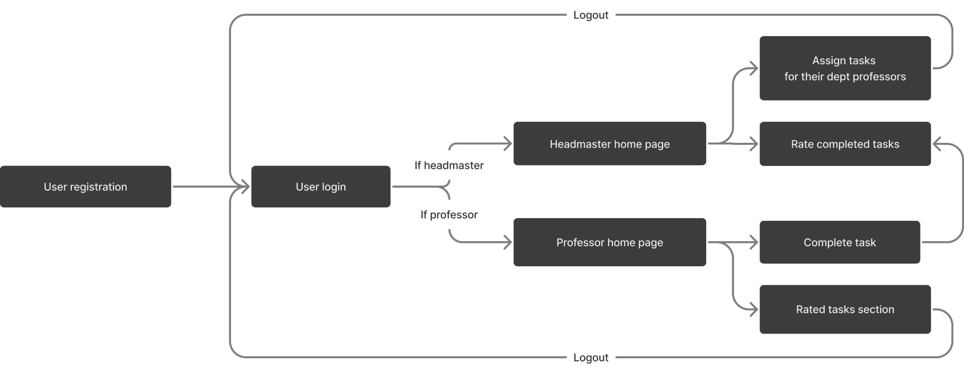
FLOW CHART

Slide 20
CONCLUSION
Succeeding in today’s work environment is tough. There are too many projects and tasks to manage. With new things popping up, things can get overwhelming. Having a task management system can make things much easier. Whether you’re looking to achieve more of your goals or controlling your time better, a task management system will sure help you.

Slide 21
REFERENCES
[1] "Time Management Statistics." Key Organization Systems. Accessed December 3, 2018.
[2] Wires, RP News. "College Students Struggle with Organizational Skills." Reliable Plant. November 15, 2006. Accessed December 03,2018.
[3] "Organizing & Time Management Statistics." Simply Productive. April 23,2014. Accessed December 03, 2018.

Slide 22
THANK YOU!

